Slide 1
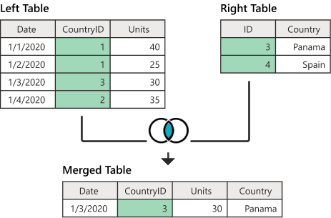
Introduction to the MySQL JOIN
So far, you have learned how to use the SELECT statement to query data from a single table.
However, the SELECT statement is not limited to query data from a single table.
The SELECT statement can link multiple tables together.
The process of linking tables is called joining.
SQL provides many kinds of joins such as inner join, outer join and cross join .

Slide 2
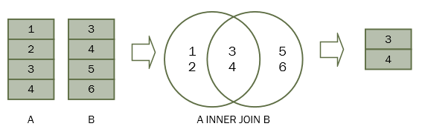
INNER JOIN
The MySQL Inner Join is used to returns only those results from the tables that match the specified condition
It is optional to use the Inner keyword with the query.
SYNTAX
SELECT <table1.column_name>,
<table2.column_name>,..
FROM table1 INNER JOIN table 2
ON (table1.column=table2.column);
Eg:
select ename, sal, dname from emp e inner join dept d on (e.deptno=d.deptno) ;

Slide 3
Qualifying Ambiguous Column Names
Use table prefixes to qualify column names that are in multiple tables.
Use table prefixes to increase the speed of parsing of the statement.
Instead of full table name prefixes, use table aliases.
Table alias gives a table a shorter name:– Keeps SQL code smaller, uses less memory
Use column aliases to distinguish columns that have
identical names, but reside in different tables.
OUTER JOIN
The inner join clause eliminates the rows that do not match with a row of the other table.
The outer join, however, returns all rows from the table whether or not there is a matching row in between tables.
LEFT OUTER JOIN
RIGHT OUTER JOIN

Slide 4
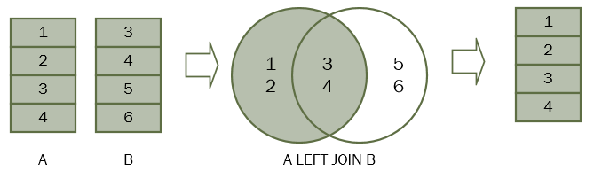
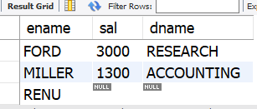
LEFT OUTER JOIN OR LEFT JOIN
The left join, returns all rows from the left table whether or not there is a matching row in the right table.
SYNTAX
SELECT <table1.column_name>,
<table2.column_name>,..
FROM table1 LEFT JOIN table 2
ON (table1.column=table2.column);
Eg:
select ename,sal,dname from emp e
LEFT JOIN dept d ON (e.deptno=d.deptno);

Slide 5
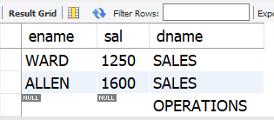
RIGHT OUTER JOIN OR RIGHT JOIN
The right join, returns all rows from the right table whether or not there is a matching row in the left table.
SYNTAX
SELECT <table1.column_name>,
<table2.column_name>,..
FROM table1 RIGHT JOIN table 2
ON (table1.column=table2.column);
Eg:
select ename,sal,dname from emp e
RIGHT JOIN dept d ON (e.deptno=d.deptno);

Slide 6
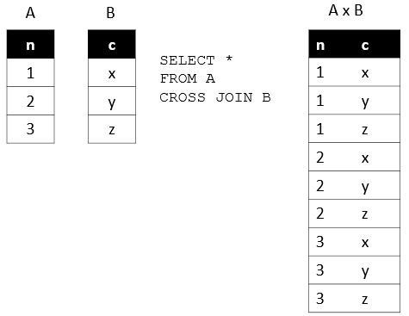
CROSS JOIN
A cross join is a join operation that produces the Cartesian product of two or more tables.
Eg:select ename,sal,dname
from emp CROSS JOIN dept ;

Slide 7
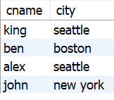

SELF JOIN
A SELF JOIN is a join that is used to join a table with itself..
Display a list of customers who locate in the same city
select c1.cname,c1.city from customers c1 inner join customers c2 on (c1.city=c2.city) where c2.cname<>c1.cname;

